Slide 1

Stock Market Analysis using Live Data
Name: Vadla Rajashekar Chary
Domain: Data Analyst
Tools: Python, ML, SQL, Excel, Yahoo Finance API

Slide 2
Content:
Analysis of stock market data for Apple, Microsoft, Netflix, Google
Used live stock data from Yahoo Finance API
Focus on trends, volatility, correlation, and prediction

Slide 3
Objective
Analyze historical stock prices
Identify price trends using moving averages
Measure stock volatility
Analyze correlation between companies
Predict stock prices using Machine Learning

Slide 4
Dataset Description
Source: Yahoo Finance API (yfinance)
Type: Live stock market data
Period: Last 3 months
Frequency: Daily prices
Companies: AAPL, MSFT, NFLX, GOOG

Slide 5
Tools & Technologies
Python
Pandas, NumPy
Matplotlib, Seaborn
Scikit-learn
Yahoo Finance API
Google Colab

Slide 6
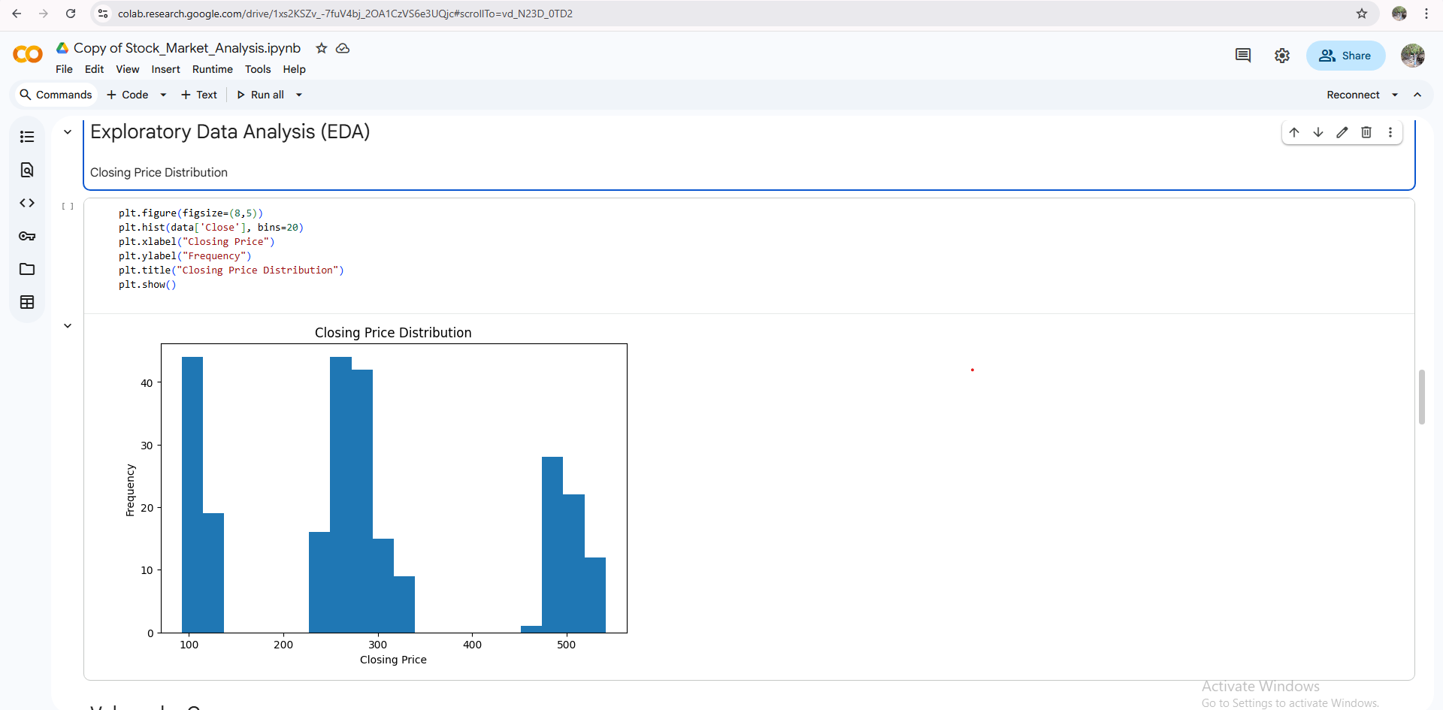
Exploratory Data Analysis (EDA)
Closing price distribution

Slide 7
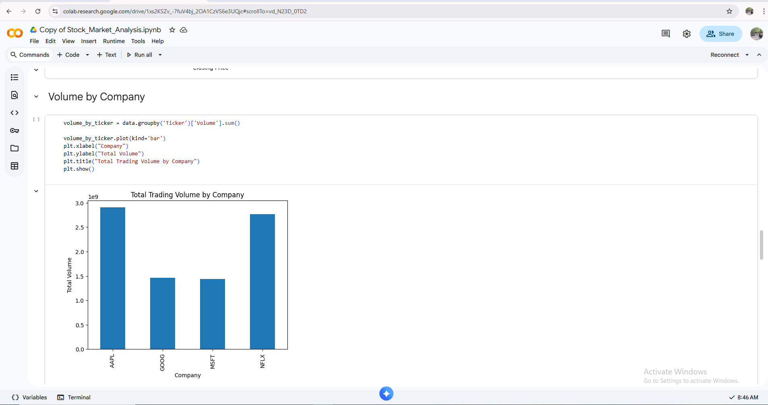
Exploratory Data Analysis (EDA)
Volume comparison

Slide 8
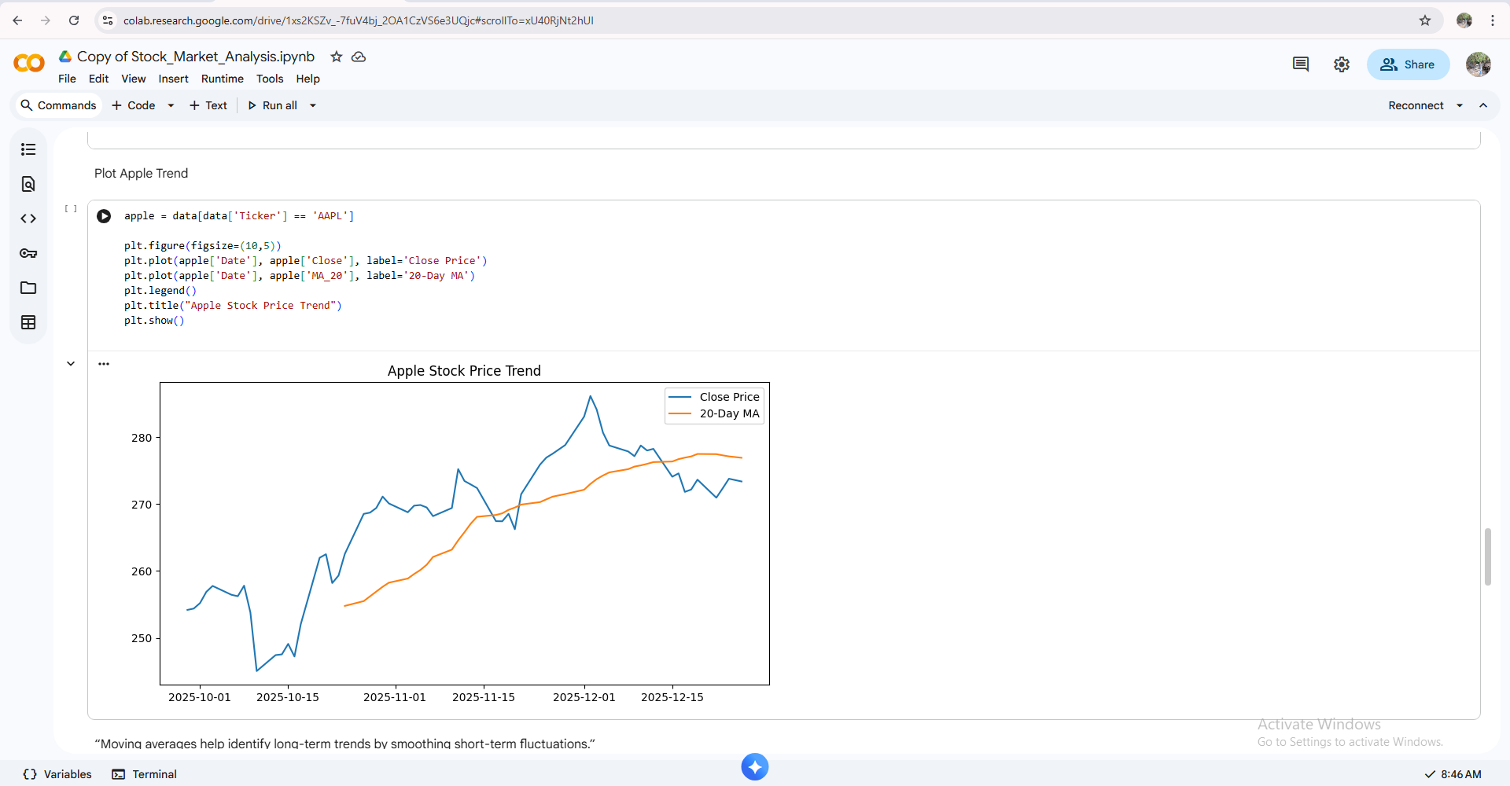
Exploratory Data Analysis (EDA)
Moving Average(Trend Analysis)

Slide 9
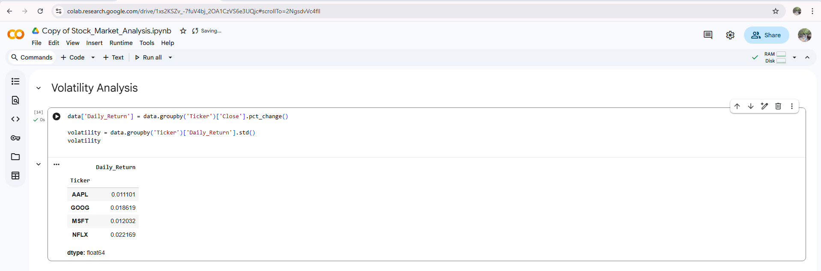
Exploratory Data Analysis (EDA)
Volatility Analysis

Slide 10
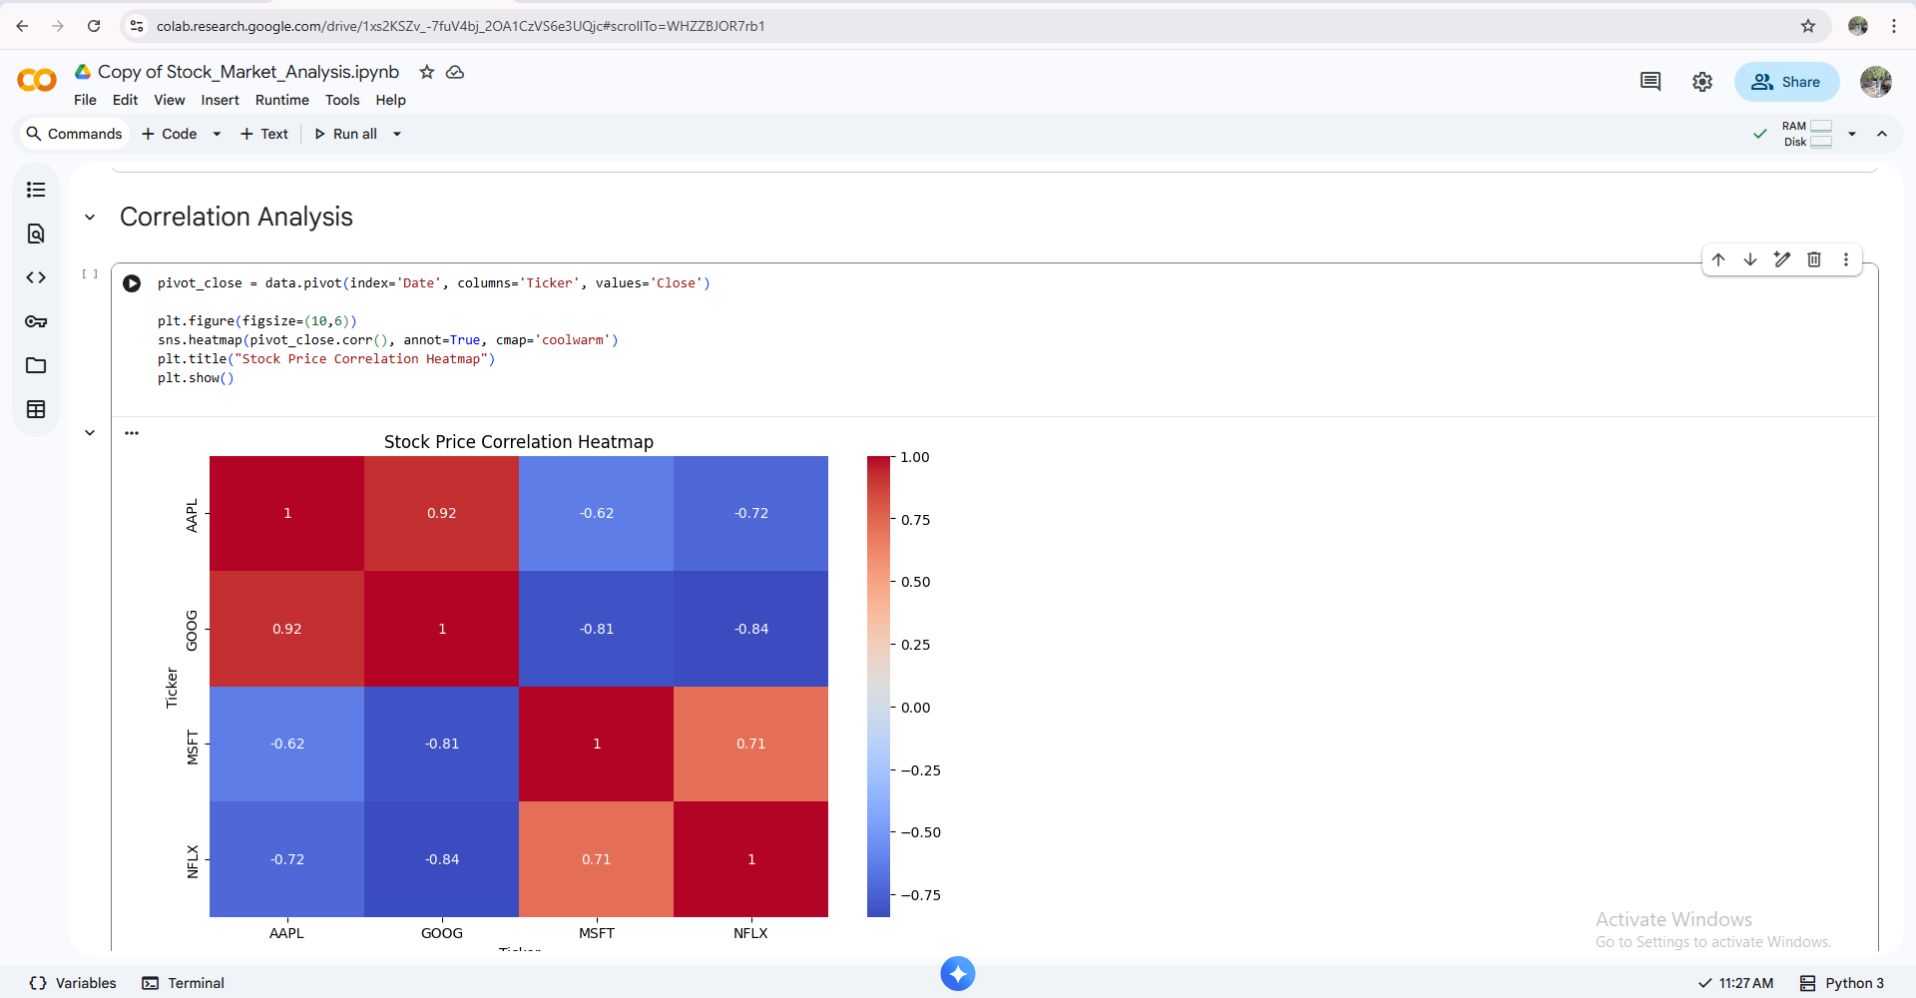
Exploratory Data Analysis (EDA)
Correlation Analysis

Slide 11
Key Insights
Apple & Microsoft are more stable
Netflix shows higher volatility
Tech stocks are positively correlated
Random Forest provides better prediction accuracy

Slide 12
Final Conclusion
• Successfully analyzed live stock market data
–Applied data analysis and machine learning techniques
–Demonstrated real-world financial data handling skills

Slide 13
Future Scope
Add LSTM deep learning model
Predict price direction (Up/Down)
Deploy using Streamlit or Flask
Automate daily stock data fetching

